Slide 1
Selenium WebDriver Training
Control Statements

Slide 2
The Golden Circle
What
What is Control statement?
The statements that define the flow of the program
Why
Why is Control Statement required?
Provide a logic based flow like chrome based vs firefox based execution
How to implement Control Statements?
How
Using Selection, Iteration and Jump Statements

Slide 3
Control Statements
Keywords & Lower case
Control
Selection
Iteration
Jump
if .. else
switch .. case
break
continue
for
for .. each
while
do while

Slide 4
Selection Statements : When to use what?
Keywords & Lower case
Control
Selection
Type | When
if . else | When you have few conditions
switch . case | When you have multiple conditions
if .. else
switch .. case

Slide 5
Selection Statements : Examples
Keywords & Lower case
Control
Selection
Type | Example
if . else | Report pass or fail
switch . case | Launch based on browser types
if .. else
switch .. case

Slide 6
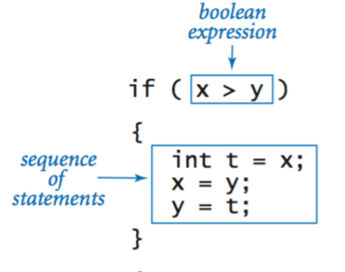
if .. else syntax

Slide 7

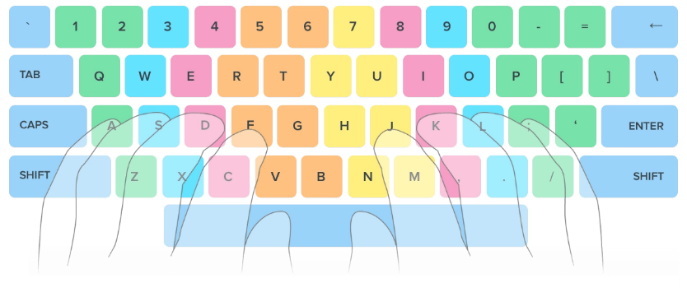
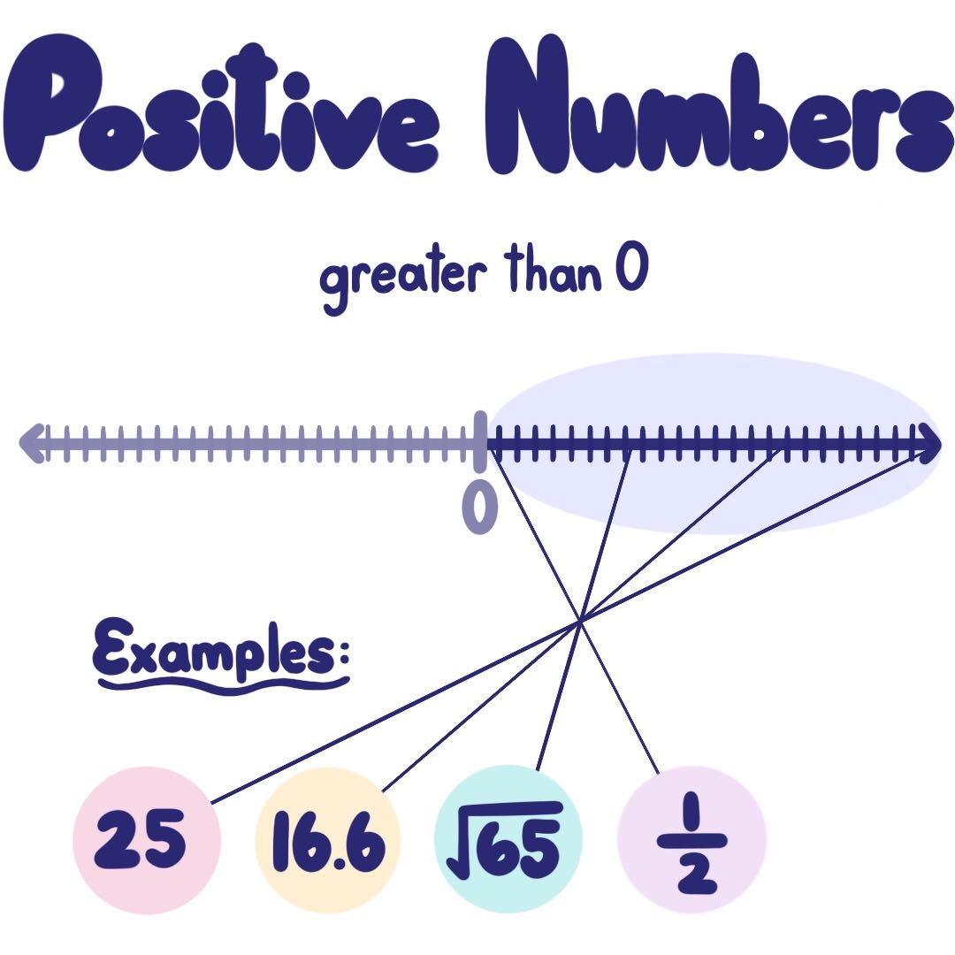
Lets write a sample code (positive number)

Slide 8
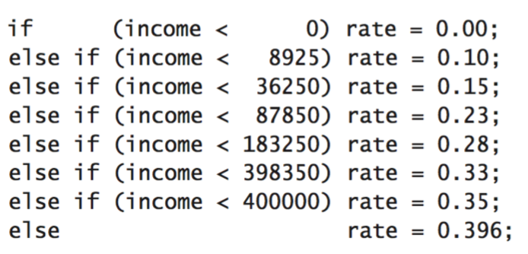
Nested if .. else syntax

Slide 9
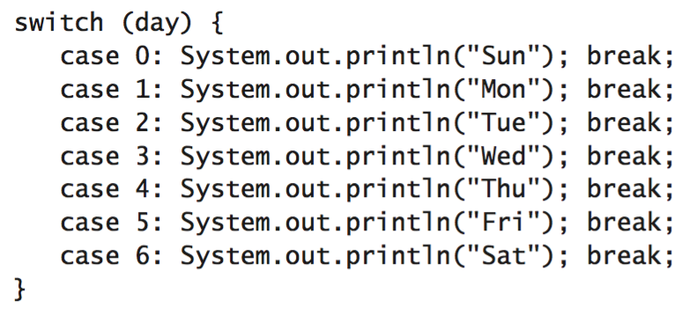
switch .. case syntax

Slide 10









Lets write a sample code (browser vendor)

Slide 11
Control Statements
Keywords & Lower case
Control
Iteration
for
for .. each
while
do while

Slide 12
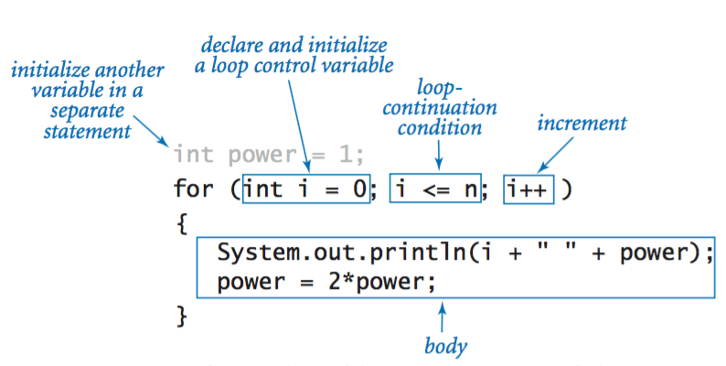
Loops (for syntax)

Slide 13
Lets write a sample code (print numbers 1 … 10)

Slide 14
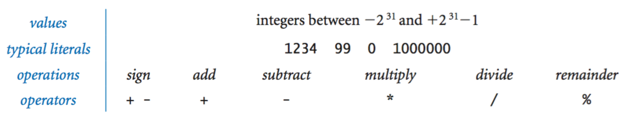
Operators (specific to integers)

Slide 15
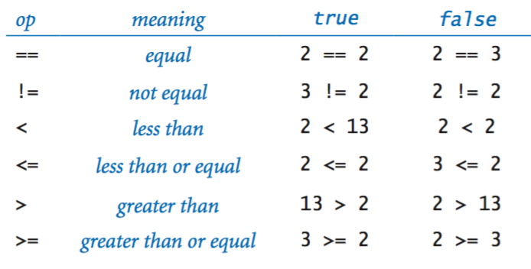
Comparison Operators

Slide 16
Summary
3 types of control statements: Selection, Iteration and Jump
Selection: if – else vs switch – case (performance oriented)
Iteration : for (count based) vs while (condition based)
Jump : break (out of iteration), continue (skip iteration)

Slide 17
Classroom Exercise (Breakout)
Write a program to print only odd numbers between 1 to 20
Before writing the code – follow the 3 step process:
Understand the problem
Solve the problem (Using Pseudocode)
Write the code

